Slide 1
Barton Stacey Parish Local History Group
BARTON STACEY REMEMBERS
Barton Stacey Chamber Choir

Slide 2
Victor Cook -
His part in
World War 1
(The Great War)
Notes:
I am going to talk to you about the enlistment of Victor Cook of this Village into the armed services as part of the country’s campaign against Germany in WW1, or the Great War, as it became known.
The talk will take into account what Army units he was assigned to, what they did, the environment he joined and how it all ended for Victor.

Slide 3
Notes:
Victor Cook was born in 1890 and was the son of Albert and Alfreda (Fanny) Cook who lived near the Vicarage in Barton Stacey. Albert Cook was one of the Village Blacksmiths at that time. Fanny was born in 1847 and was living in Wherwell when she met Albert. Their son, Victor, was one of eight brothers and three sisters and by the time he was 6 years old, in 1896, his Father had passed away leaving Fanny to cope with the family. By 1911 he had been trained as a domestic coachman which meant that he was qualified to drive most motorised vehicles on the onset of the Great War. Victor married Rosina Andrews in 1913 and they resided at 14 City Road in Winchester. There were no children at the time.

Slide 4
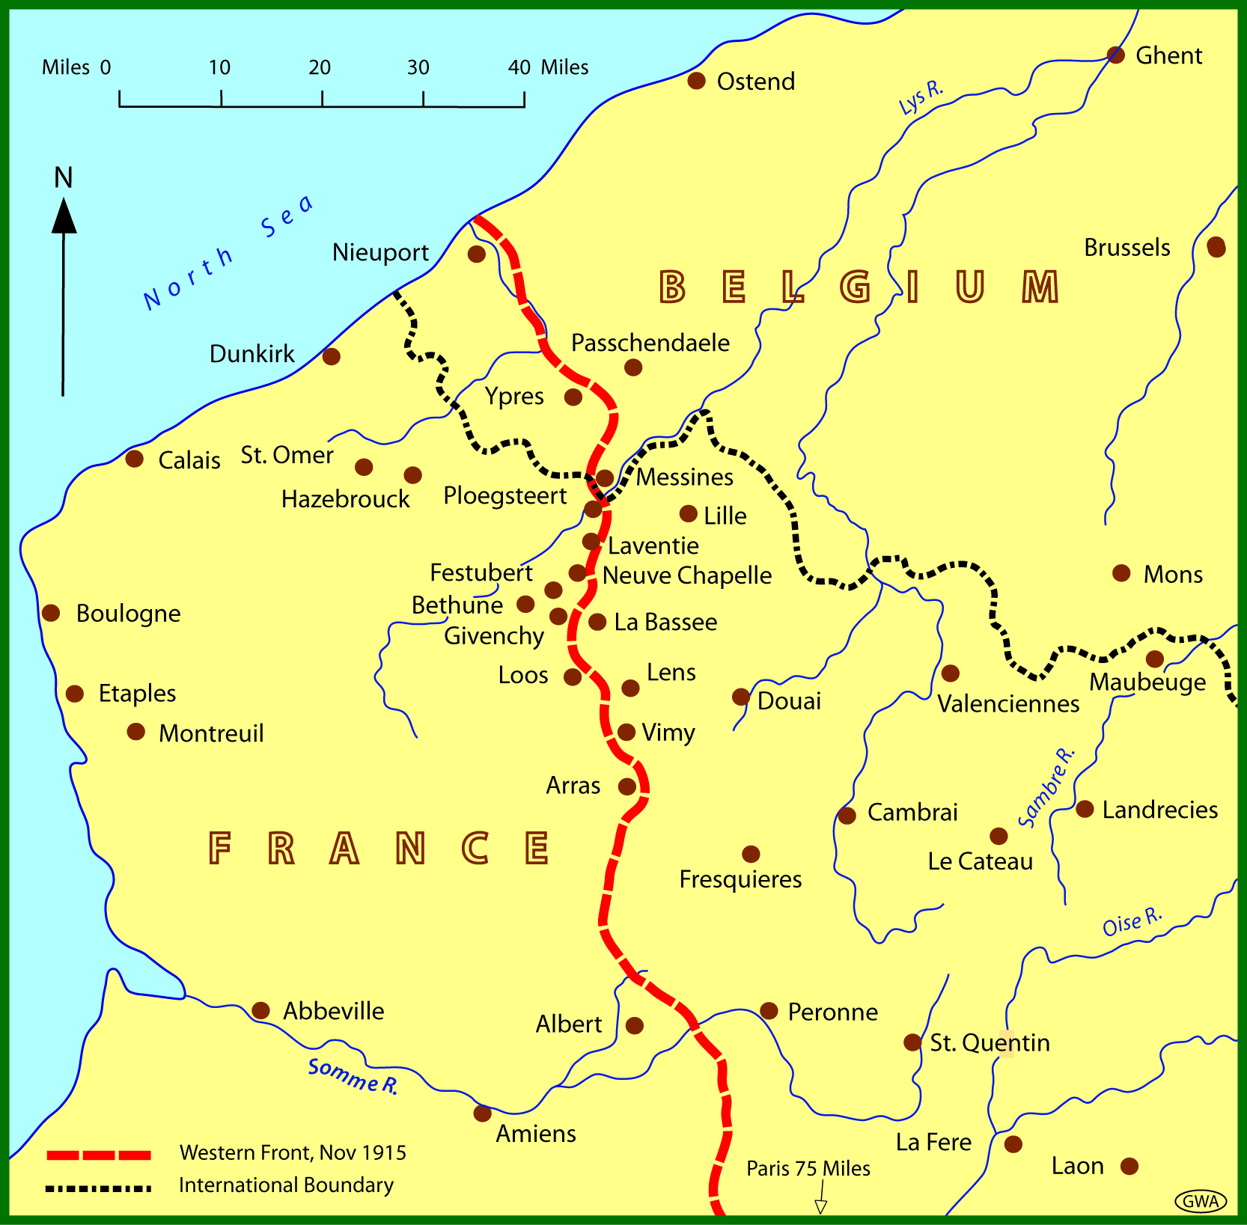
THE WESTERN FRONT - 1915
Notes:
Records are vague and uncertain but by the time Victor Cook enlisted Great Britain had been at War with Germany for over a year. The European battlefield at that time was primarily centred on the Franco/Belgium border and became known as the Western Front

Slide 5
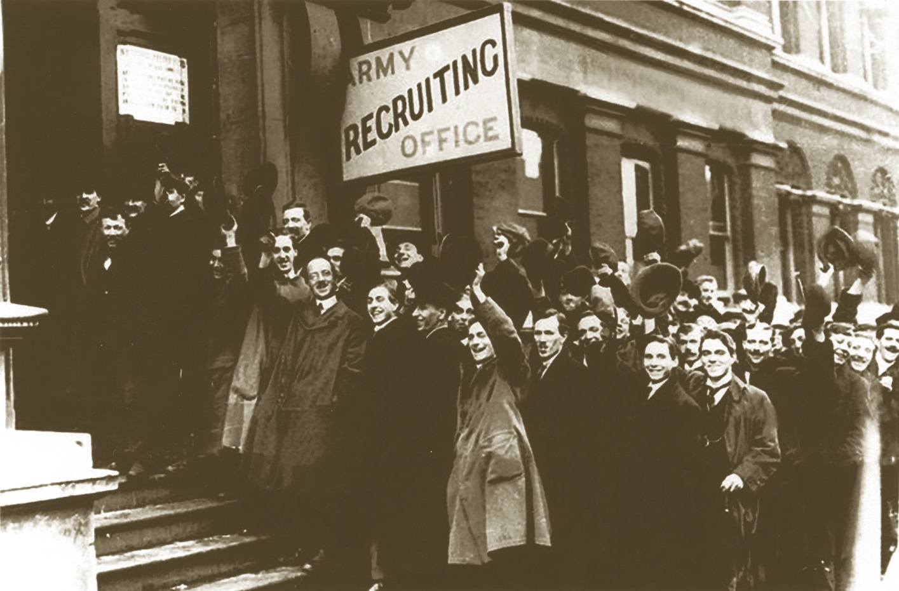
The Great War -Recruiting
Notes:
Victor, along with thousands of other volunteers, joined a campaign that had become a turgid struggle resulting in siege conditions along the Front, between two entrenched armies, with the British and its imperial troops on one side and the massive German Army on the other.

Slide 6
THE WESTERN FRONT - 1915
Notes:
By November 1914 the War, which has frozen into a deadly stasis, developed into a chaos of massive assaults from both sides involving thousands of troops and artillery bombardments.

Slide 7
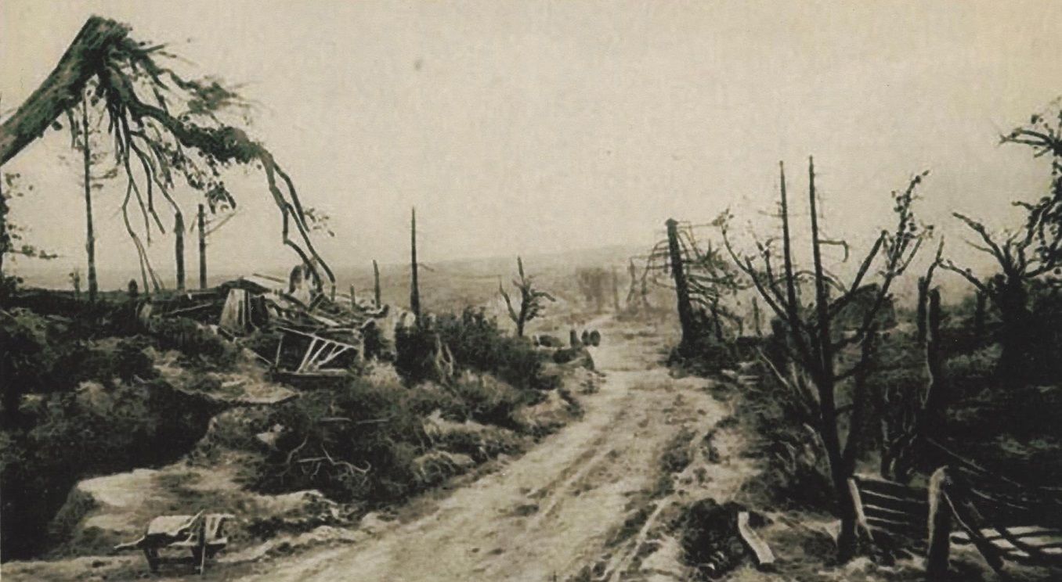
SOUTHERN PART OF THE WESTERN FRONT – 1915
(THE SOMME BATTLEFIELD)
Notes:
The loss of life was enormous with hundreds of enemy and own troops being killed on every assault, the result of which might gain the attacking side a few hundred yards, probably to be lost on the next assault by the opposing side.

Slide 8
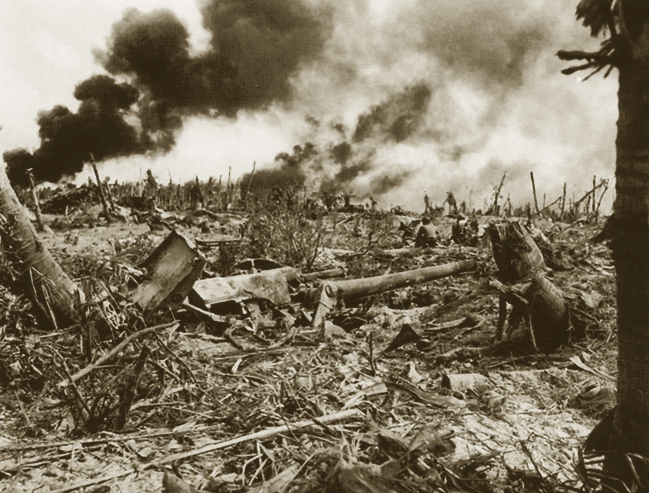
The devastation
after the
Battle of the Somme
On the
Western Front
Notes:
In fact, it is known that on one day alone, 56,000 allied troops perished on the Somme. All this, which in the winter, was usually fought over cold, muddy, treeless and devastated

Slide 9
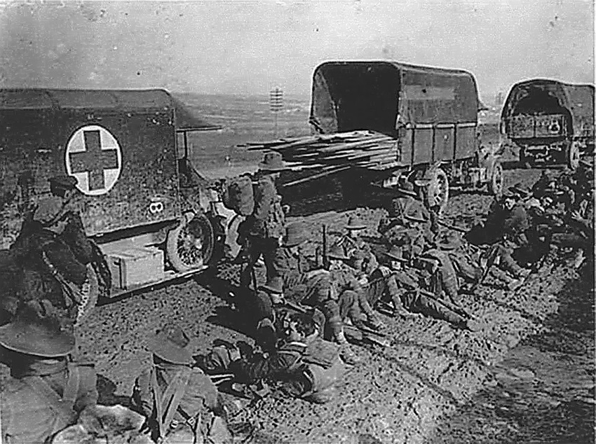
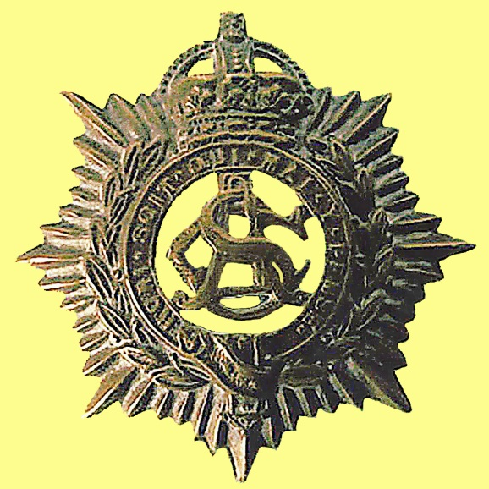
M/317823
Private V Cook
ASC
ASC Transport on the way to the Front
Notes:
25 year-old Victor joined this war as a Private in the, then, Army Service Corps or ASC. A lot of you most probably know that it became known as the Royal Army Service Corps, or RASC. In common with every other soldier, he was assigned a service number which was M/317823. I only mention this small detail as it has some significance later.
Now, a little about what the ASC did in those days of World War One. The main role of the Corps was the provision and supply of food, petrol, lubricants, other fuels and light, hospital supplies and disinfectants. In addition the Corps also provided the transport, either motorised or horse-drawn, for the afore-mentioned items together with ammunition, engineer stores, ordnance stores and post, from the railhead, or base, to all units making up the forces in the field.

Slide 10
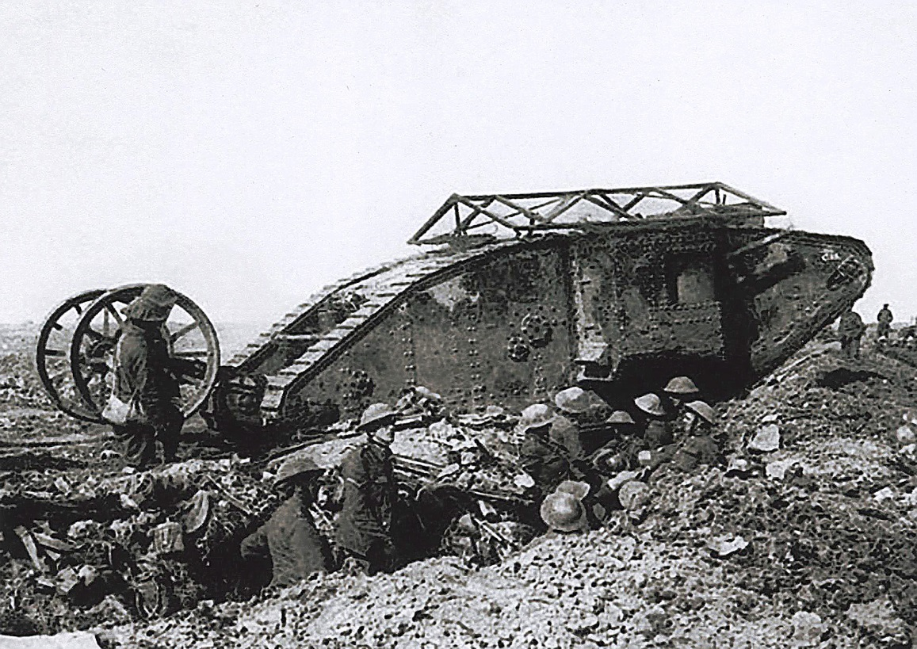
Army
Service
Corps
A Mk. 2 First World War tank
Notes:
In addition the Corps provided for the carriage of Infantry, tanks and heavy bridging equipment. All personnel of the ASC were trained to fight as infantry and were responsible for their own defence. (As a matter of interest many elements of the RASC were re-mustered as the Royal Corps of Transport, or RCT, after an Army re-organisation in 1965). Victor was already a motorised vehicle driver, as mentioned earlier, as I believe from his service number prefix, ‘M’, that he was a mechanical transport driver as opposed to operating horse transport.
Early in his time with the ASC, and thereafter for the remainder of his service, he was attached to the 185th Tunnelling Company of the Royal Engineers as a driver of a motorised vehicle.

Slide 11
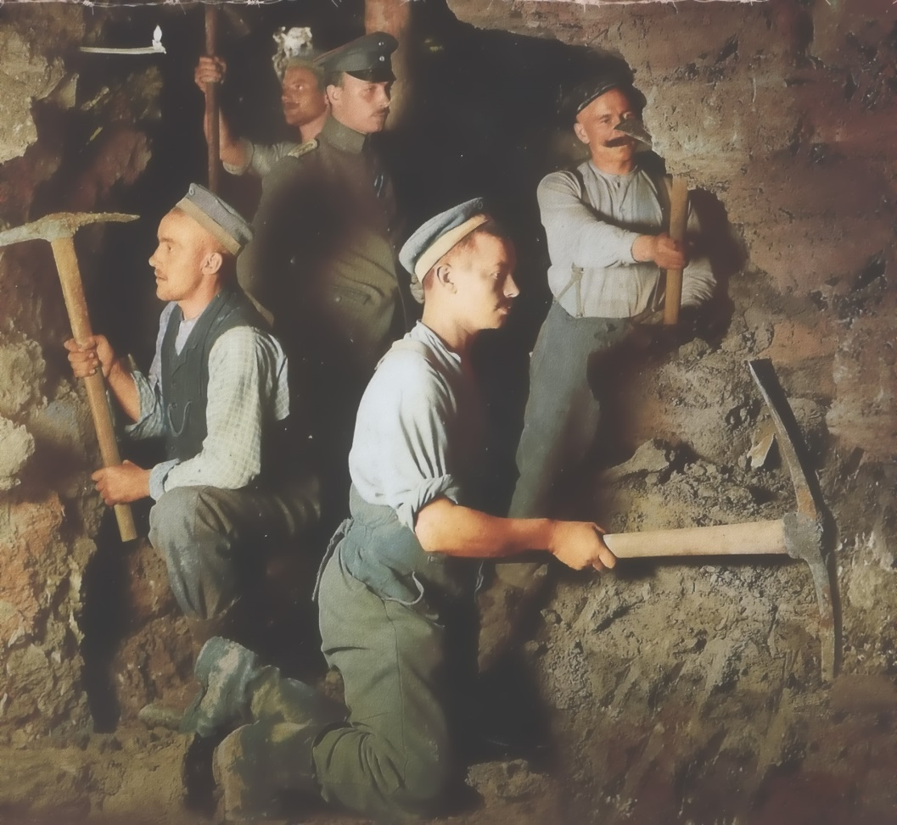
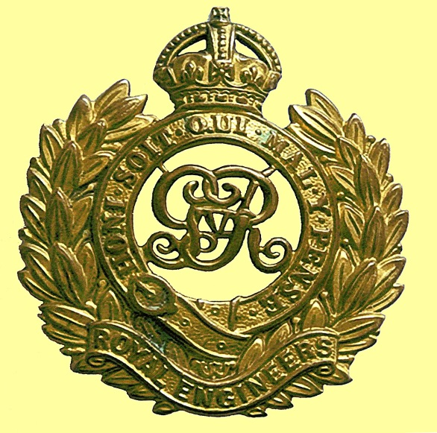
M/317823
Private V Cook
ASC then attached to
The Royal Engineers
(RE)
Tunnelling Scene - (from RE Museum)
Notes:
Because Tunnellers were considered to be particularly valuable troops, Tunnelling Companies were lucky enough to have motor Lorries and a box car for the officers, that all came with their own ASC drivers.
As I mentioned earlier, the siege conditions that had developed in late 1914 meant that both sides needed a method of breaking through the enemy’s defensive entrenched positions. It was not long before the ancient art of mining under the enemy lines was remembered, placing explosives in those mines and blowing them up. As a tragic example, on 20th December 1914 ten small mines packed with explosives had been driven under the British positions and blown - causing 800 men of the Indian Corps to be lost during an infantry attack. By January 1915 it was evident that the Germans were beginning to mine on an organised system and this had to be countered.

Slide 12
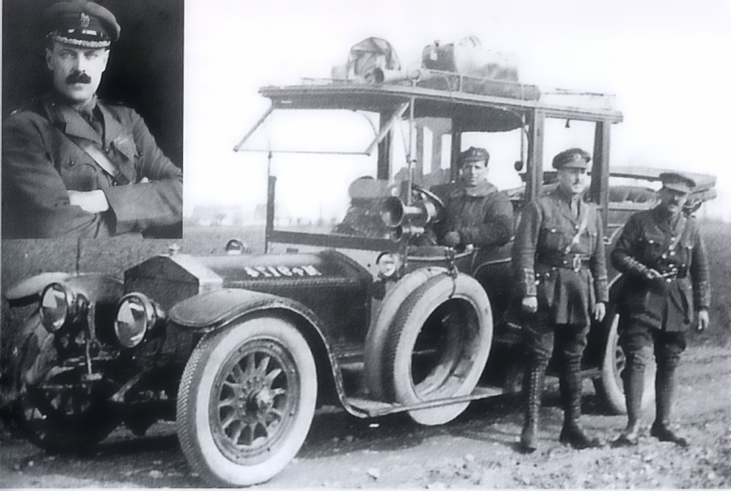
(Courtesy of RE Museum)
Sir John Norton-Griffiths MP,
whose idea to raise Tunnelling Companies,
was authorised by the War Office in early 1915
Notes:
The British response was the rapid formation of specialist units, an initiative by Major Sir John Norton-Griffiths RE, a respected MP, within the Corps of Royal Engineers to carry out mining, or tunnelling, and demolition duties. (This picture shows him standing alongside his wife’s 2-ton Rolls-Royce, c/w driver, which he took to war.) Most of the initial input of soldiers to these units, had previous mining skills, such as those employed on the London Underground or coal mining before the War, and were drawn from within the existing ranks of the Royal Engineers as well as the rest of the Army.

Slide 13
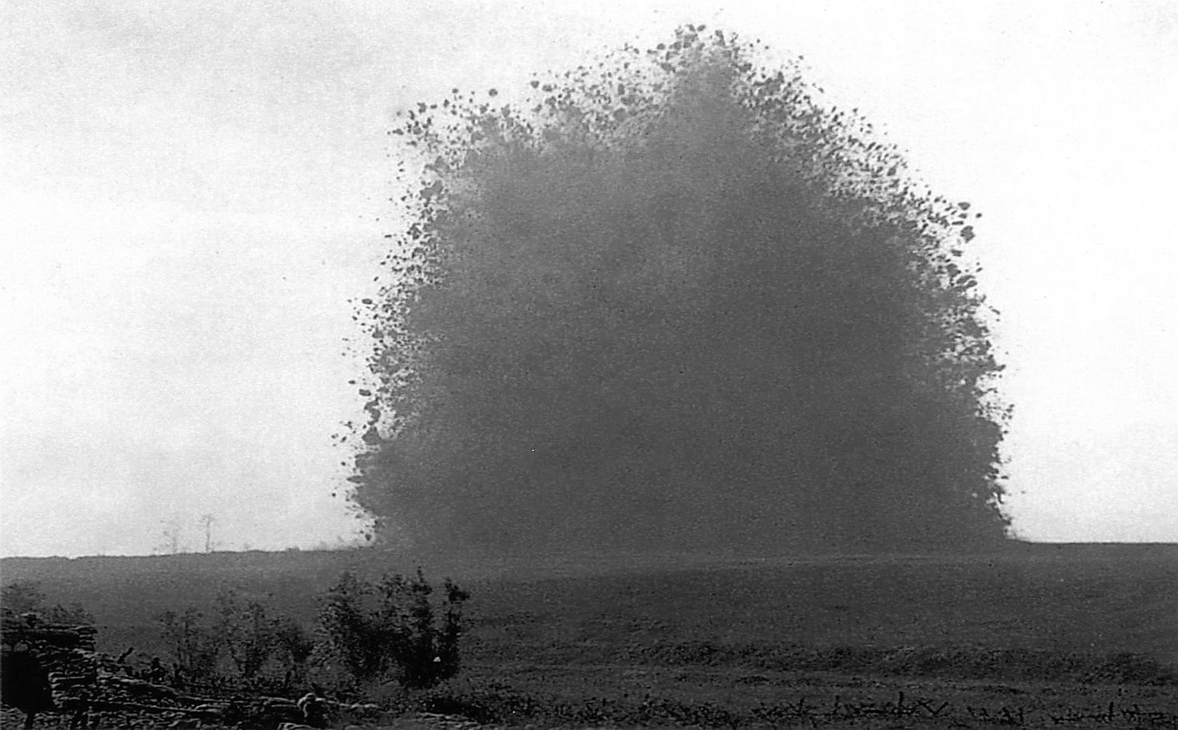
Blowing a mine by the 185th Tunnelling Company RE
at La Boissselle 1916
Notes:
On 17th February 1915 the first British mine was blown at the infamous ‘Hill 60’ by Royal Engineer, or Sapper, troops. Such was the need to counter the German ‘underground offensive’ that by early 1916 over 26 tunnelling Companies had been raised.

Slide 14
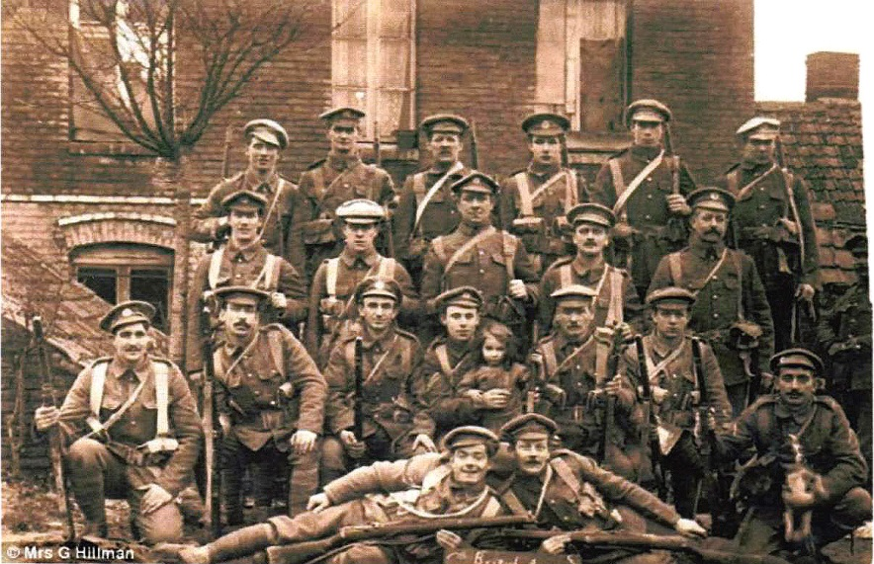
A section of the 185th Tunnelling Company Royal Engineers 1916
Notes:
It is not certain when Private Victor Cook joined the 185th Tunnelling Company but it was almost certainly at the time that the unit was formed in Rouen in October 1915 under the command of the British General Headquarters. It then moved immediately to the Somme area,

Slide 15
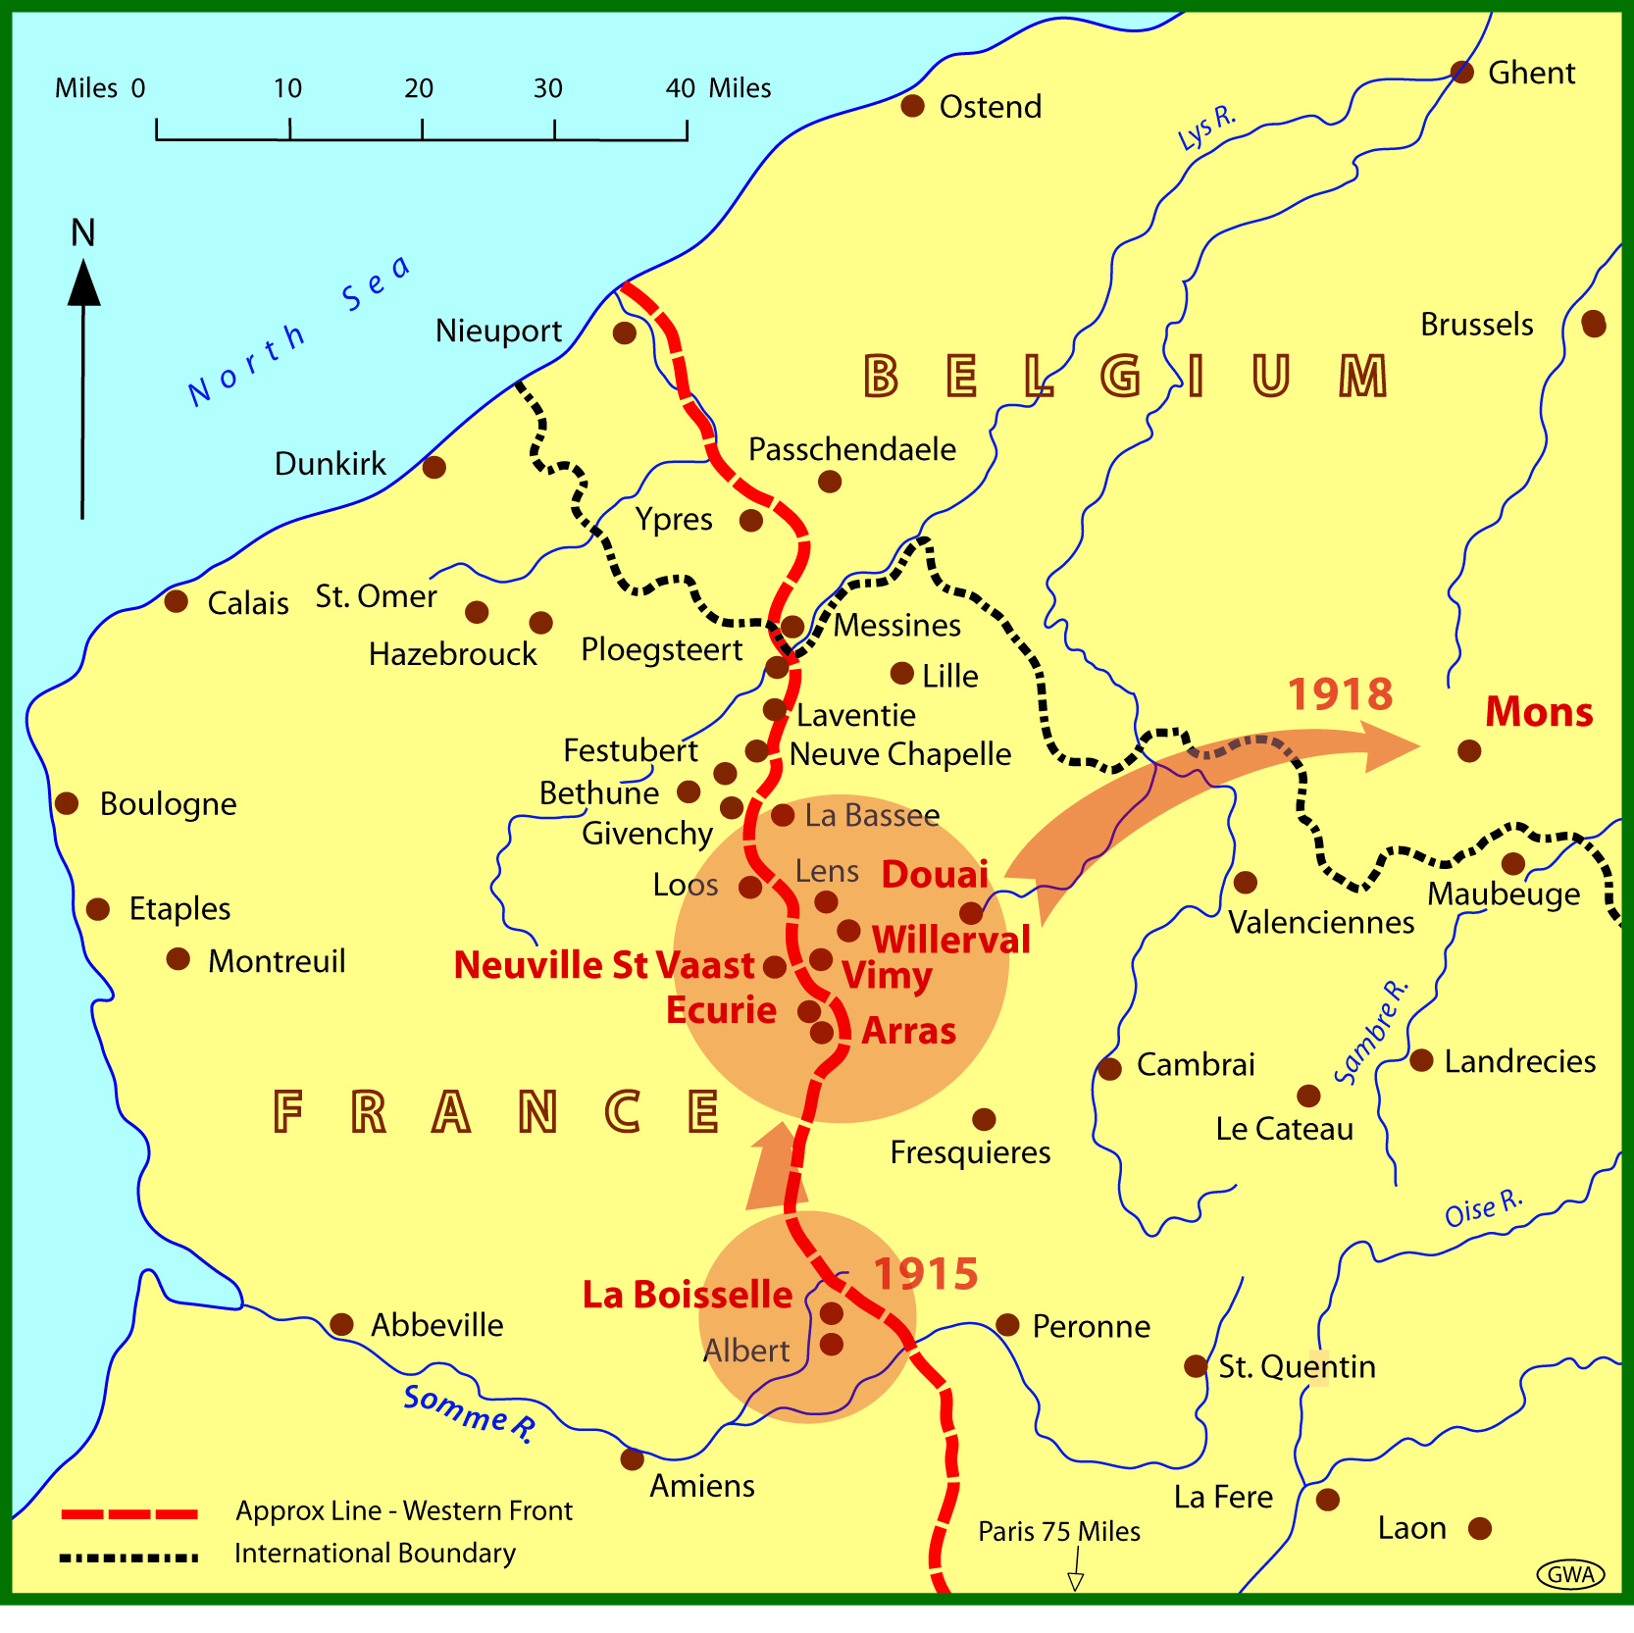
The Great War
The operational
Movements of
185th Tunnelling
Company RE
1915 - 1918
Notes:
for tunnelling works at la Boisselle along with the 175th Tunnelling Company. The company then moved to the Labyrinth sector near Vimy in March 1917. Here, as in other areas, the company were constantly under attack from their German counterparts whilst tunnelling. In one major incident on the Vimy Ridge, their company Commander, Captain T E Richardson RE, Lt. A J Latham and 16 Sapper Tunnellers were instantly killed by a German Camourflet (an underground pipe-like explosive device). The resulting explosion also caused the gassing of Lt. S Hill and a further 2 Sappers by carbon monoxide poisoning.
The company then dug subways near Neuville St Vaast in May 1917 and were part of the Battle of Vimy, the first and second battles of the Scarpe before moving on to Lestrem.
By the beginning of August 1917 they had joined the British First Army for the Battle of Hill 70, near Arras. Later in September the company tunnelled at Ecurie and later at Willerval. The Sappers was then involved in the huge assault at the Third Battle of the Scarpe between 26 – 30th August in 1918.
As part of the Pursuit to Mons the 185th Tunnelling Company were some of the first troops to enter Douai on 17th October 1918, during, what was to become known as, ‘The Great Advance to Victory’ in the pursuit of the German Army to Mons.
In the last months of the war the 185th Tunnelling Company was engaged in booby trap removal with widely detached parties spearheading, or following closely, the British advance.
At the time of the Armistice, on the 11th November 1918, they were mostly in the area north west of Mons.

Slide 16
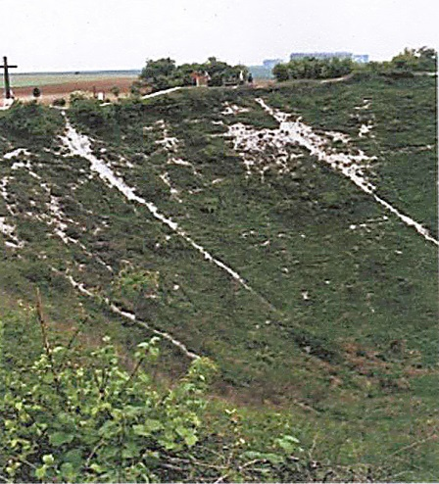
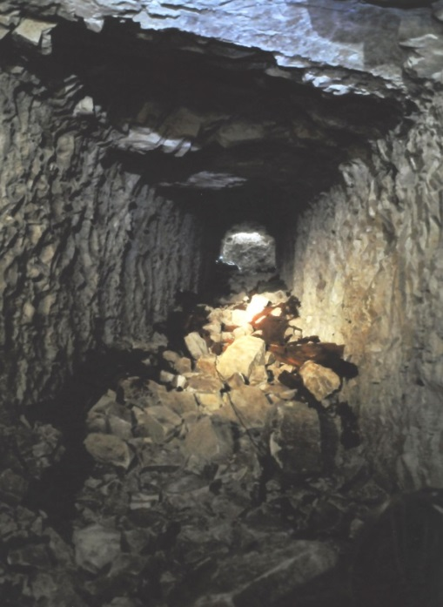
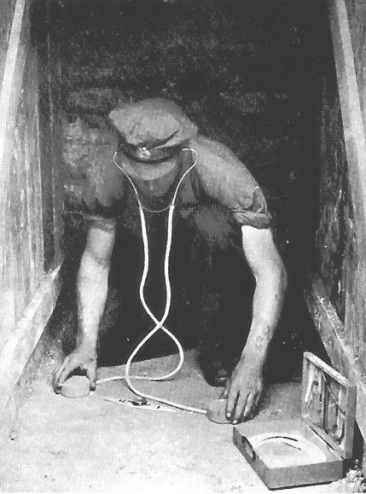
Tunnel with spoil
awaiting collection
Using a Geometer (Listening for the Enemy!)
Legacy of a blown mine –
A crater at the Somme today
Notes:
During all this time Private Victor Cook was involved not only with driving his vehicle, often under fire, but also assisting the Sappers in their mining operations. You can imagine conditions below ground, the soldiers often working in cramped and flooded conditions.
The attached ASC soldiers were used as ‘fetchers and carriers’, such as removing the spoil during the mining phase. Tunnelling, by its very nature, was, and still is, an exhausting, claustrophobic and hazardous occupation fraught with many dangers including possible death from tunnel collapses, being shot by oncoming enemy troops who had broken into a tunnel or, as I mentioned earlier, the possibility of dying from carbon monoxide poisoning after explosions (a not uncommon occurrence). Tunnelling Companies worked around the clock, 24/7, so the Sappers and the other attached soldiers such as Victor Cook, worked in shifts taking their breaks and meals wherever they were at that moment in time.
Here you see a Sapper Tunneller using a geometer (a sort of Stethoscope) listening out for enemy tunnelling activity below his own tunnel. They often had to ‘freeze’ from working to achieve complete silence, fearful of alerting the Germans.
This recently-taken picture shows the extent of a crater formed by a mine explosion in the Somme area. The enormous hole in the ground is emphasised by the people standing around the rim. Hence the reason it became known as the Underground War.

Slide 17
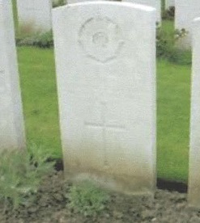
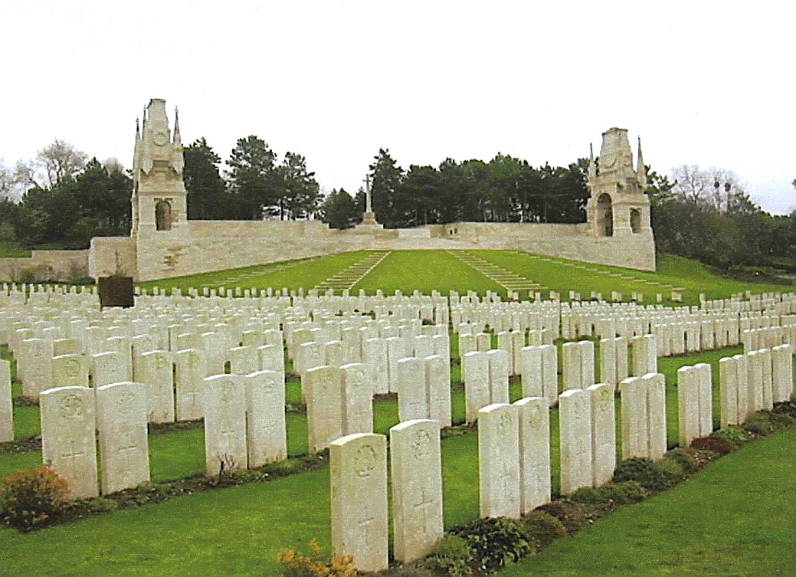
Etaples Military Cemetery, France
Victor Cook’s
Grave
Notes:
The tragic aspect of the life of Private Victor Cook was that he died on the 14th November 1918, three days after the Armistice, but he does not appear to be listed in the Soldiers killed in the Great War in the Unit’s War dairies. However this is probably because on 19th October 1918 there is a reference to a very ill private soldier being taken to the Military Base Hospital at Etaples but he was not named. From his place of burial at the Le Treport Military Cemetery, Nr Etaples, it can be deduced that it was almost certainly Victor who, we know, died of Broncho-Pneumonia – possibly triggered by carbon monoxide poisoning

Slide 18
In common with many service personnel of the Great War , Victor Cook was entitled to:
The Victory Medal
(This medal was awarded to those who had been mobilised and served after 4/5th August 1914 up until 11/12th November 1918)
The British War Medal
(This medal was automatically awarded in the event of death on active service in the Great War)
Notes:
For his efforts and sacrifice he would have been entitled to receive the Victory and the British War Medals.

Slide 19
Victor Cook -
His part in
The Great War
Thank you for listening

